Slide 1
Spring Webflux (by Coroutine)
소개 및 환경구성

Slide 2
Spring Webflux
소개 및 환경구성
최소한의 H/W 자원으로 동시성을 처리하는 Non-blocking Web stack
First release : 2017.08 (from Spring 5)
Webflux
MVC
Spring Data Reactive
Mongo, Cassandra, Redis, Couchbase, R2DBC
Spring Data
JDBC, JPA, NoSQL
Spring Webflux
Spring MVC
Spring Security Reactive
Spring Security
Reactive Streams Adapter
Servlet API
Netty
Servlet Container

Slide 3
구성요소
소개 및 환경구성
Netty
Async process Reactor, Kotlin Coroutine
R2DBC

Slide 4
구성요소
소개 및 환경구성
Netty
Async process Reactor, Kotlin Coroutine
R2DBC

Slide 5
구성요소
소개 및 환경구성
Netty
Async process Reactor, Kotlin Coroutine
R2DBC

Slide 6
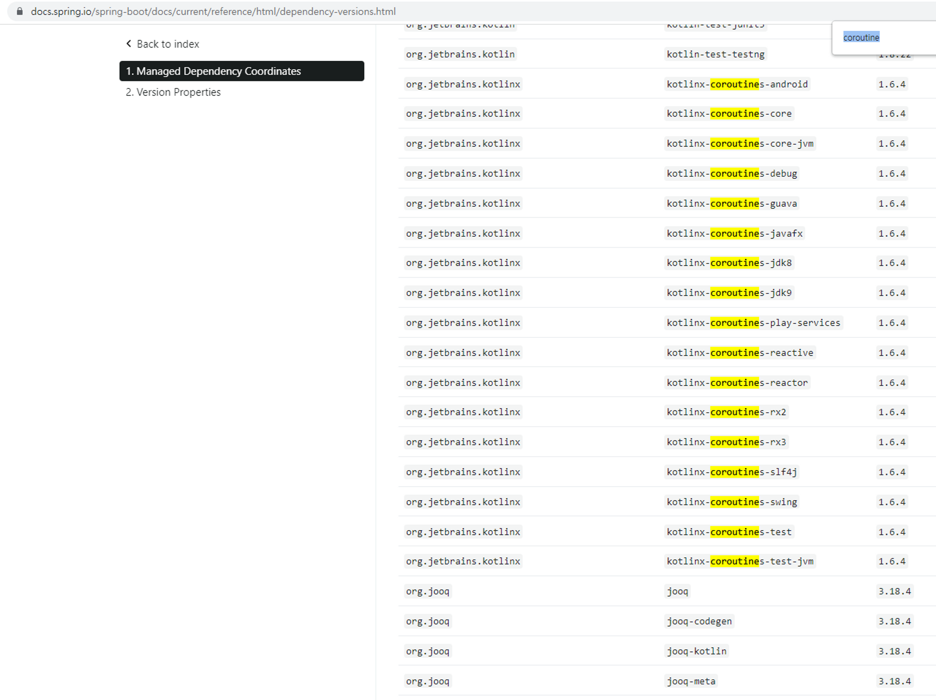
Spring Webflux for Kotlin Coroutine
소개 및 환경구성
from Spring 5.2 (2019.11.04)
https://github.com/spring-projects/spring-framework/wiki/What's-New-in-Spring-Framework-5.x#whats-new-in-version-52

Slide 7
Spring Webflux for Kotlin Coroutine
소개 및 환경구성
WebFilter
org.springframework.web.server
DispatcherHandler
org.springframework.web.reactive
RequestMapping HandlerAdapter
org.springframework.web.reactive
HandlerAdaptor
org.springframework.web.reactive
InvocableHandlerMethod
org.springframework.web.reactive
CoroutinesUtils
org.springframework.core
coroutine function

Slide 8
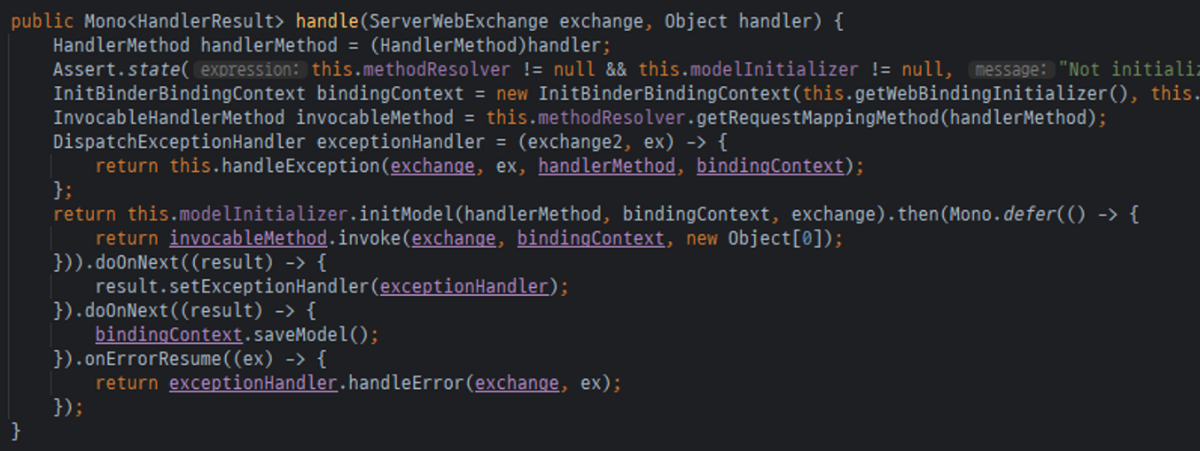
Spring Webflux for Kotlin Coroutine
소개 및 환경구성
WebFilter
org.springframework.web.server
DispatcherHandler
org.springframework.web.reactive
RequestMapping HandlerAdapter
org.springframework.web.reactive
InvocableHandlerMethod
org.springframework.web.reactive
CoroutinesUtils
org.springframework.core
coroutine function

Slide 9
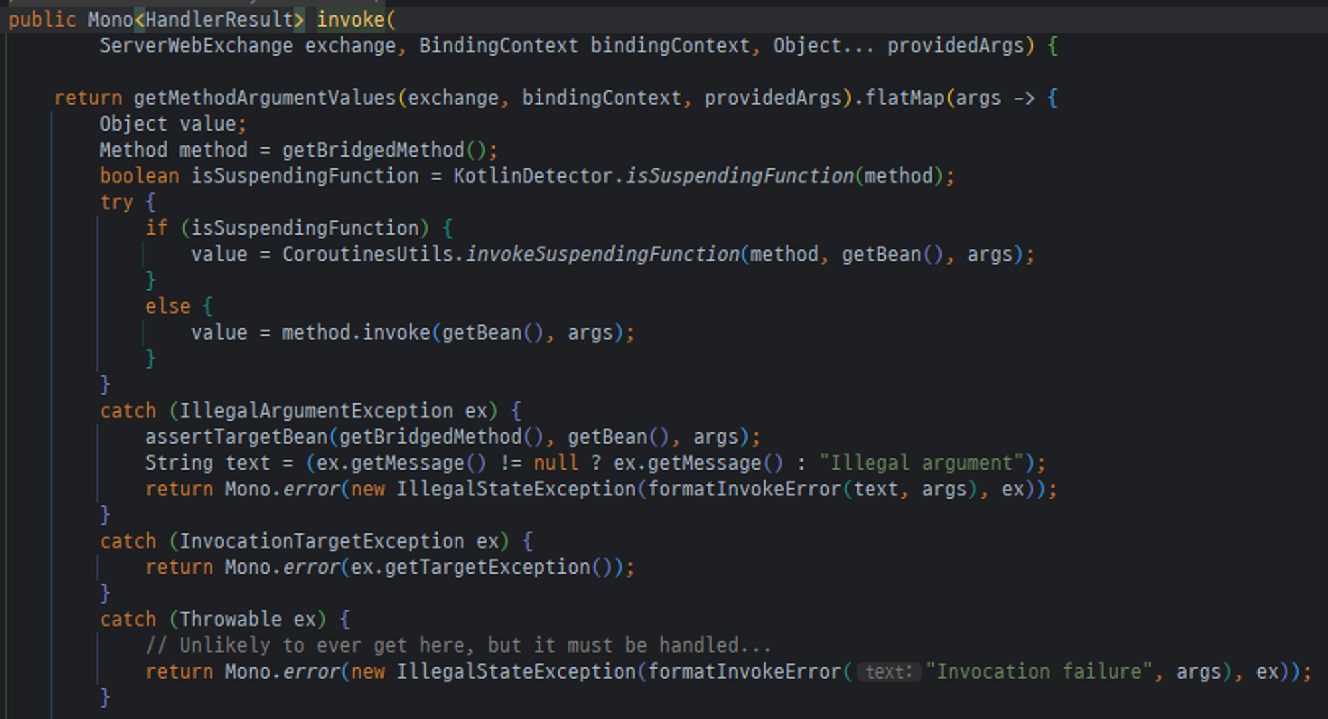
Spring Webflux for Kotlin Coroutine
소개 및 환경구성
WebFilter
org.springframework.web.server
DispatcherHandler
org.springframework.web.reactive
RequestMapping HandlerAdapter
org.springframework.web.reactive
InvocableHandlerMethod
org.springframework.web.reactive
CoroutinesUtils
org.springframework.core
coroutine function

Slide 10
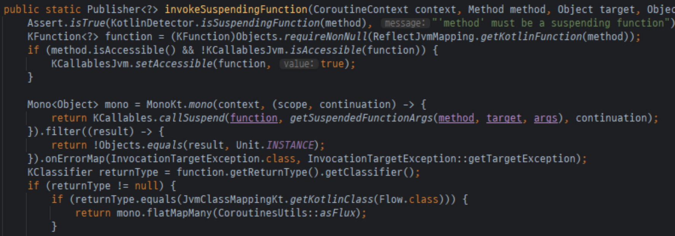
구현내용 및 개발환경 구성
소개 및 환경구성
WebFilter
org.springframework.web.server
DispatcherHandler
org.springframework.web.reactive
RequestMapping HandlerAdapter
org.springframework.web.reactive
InvocableHandlerMethod
org.springframework.web.reactive
CoroutinesUtils
org.springframework.core
coroutine function

Slide 11
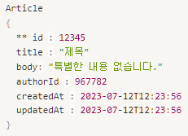
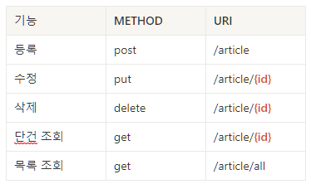
구현내용 및 개발환경 구성
소개 및 환경구성
구현내용
자료구조
API

Slide 12
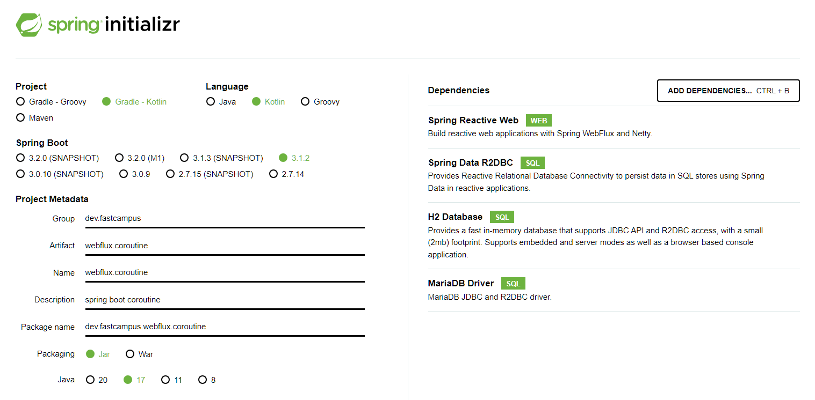
구현내용 및 개발환경 구성
소개 및 환경구성
Spring initializr
https://start.spring.io
https://start.spring.io/#!type=gradle-project-kotlin&language=kotlin&platformVersion=3.1.2&packaging=jar&jvmVersion=17&groupId=dev.fastcampus&artifactId=webflux.coroutine&name=webflux.coroutine&description=spring%20boot%20coroutine&packageName=dev.fastcampus.webflux.coroutine&dependencies=webflux,data-r2dbc,h2,mariadb

Slide 13
Spring Webflux (by Coroutine)
서비스 구현

Slide 14
구현 실습
Hello world API 구현

Slide 15
구현 실습
CRUD 서비스 구현

Slide 16
구현 실습
Unit 테스트 (Kotest)

Slide 17
Unit 테스트 (Kotest)
서비스 구현
Kotest
https://kotest.io
https://kotest.io/docs/extensions/spring.html

